Slide 1

Software Engineering
ML22-23-8: Implement the SDR representation in the MAUI application
--o-- Winter Semester 2023/24 _ Damir Dobric -o--
Anh Tong Ngoc Minh - 1317815
Son Pham Tien - 1318513

Slide 2
1. Introduction
Work with .NET MAUI: a cross-platform framework. Implement a MAUI App visualizing Sparse Distributed Representations (SDR).
Scope of the project:
Hardware and software requirements
How to implement the required MAUI app
Evaluate the test results
Possible improvements
Implementation of App SDR steps:
Create a User Interface (UI) in the MAUI getting inputs data and configurations
Modify the logic behind the UI elements
Generate and implement an SDR drawing library to visualize the input data based on requirements.

Slide 3
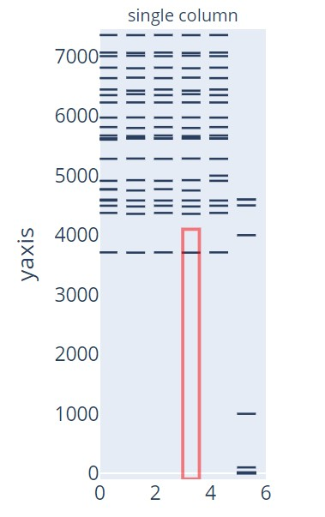
2. Requirements and Getting Started
a. Requirements [1]
Implement the MAUI app used for SDR representation, with follows:
Draw the similar SDR representation like in file draw_figure.py
Use library Maui.Graphics
All arguments taken in via UI (data and parameters).
Implement drawing functionality with the created SdrDrawerLib
Figure 1: Example of SDR representation

Slide 4
2. Requirements and Getting Started
b. Getting Started
The project integrates the latest update
➔ Install at least the following version of IDE, text editor, and MAUI.
Microsoft Visual Studio Community 2022 - v17.8.6 -https://learn.microsoft.com/en-us/visualstudio/releases/2022/release-notes-v17.8
.NET MAUI 8.0 - when installing Visual Studio, choose .NET MAUI to integrate along with the installation.
➔ From v17.8.6, .NET MAUI 8.0 automatically supported.
More information: https://github.com/tongngocminhanh/MAUI_App_SDR/tree/master/MySEProject

Slide 5
3. Implementation of App SDR
a. UI implementation

Slide 6
3. Implementation of App SDR
b. Logic implementation

Slide 7
3. Implementation of App SDR
c. SDR drawing library implementation

Slide 8
4. Testing and evaluation
a. Testing

Slide 9
4. Testing and evaluation
b. Evalution

Slide 10
5. Conclusion

Slide 11
Referenced sources
[1] D.Dobric, “Project ideas 2018-2023”, Frankfurt am Main, Germany. Frankfurt University of applied Sciences, October 2023. Accessed on: https://github.com/UniversityOfAppliedSciencesFrankfurt/se-cloud-2023-2024/blob/main/Project%20Ideas%202018-2023.docx.

Slide 12
Demo part

